Slide 1
(Un)conditional love and compassion: Reading of QS Al-Mumtahanah (60): 8-9 in three Indonesian Contemporary Exegetes
Ahmad Rafiq

Slide 2
لاَّ يَنْهَاكُمُ ٱللَّهُ عَنِ ٱلَّذِينَ لَمْ يُقَاتِلُوكُمْ فِي ٱلدِّينِ وَلَمْ يُخْرِجُوكُمْ مِّن دِيَارِكُمْ أَن تَبَرُّوهُمْ وَتُقْسِطُوۤاْ إِلَيْهِمْ إِنَّ ٱللَّهَ يُحِبُّ ٱلْمُقْسِطِينَ }
[60:8] Allah forbiddeth you not those who warred not against you on account of religion and drove you not out from your homes, that ye should show them kindness and deal justly with them. Lo! Allah loveth the just dealers.
God does not forbid you in regard to those who did not wage war against you from among the disbelievers on account of religion and did not expel you from your homes that you should treat them kindly an tabarrūhum is an inclusive substitution for alladhīna ‘those who’ and deal with them justly this was revealed before the command to struggle against them. Assuredly God loves the just.
{ إِنَّمَا يَنْهَاكُمُ ٱللَّهُ عَنِ ٱلَّذِينَ قَاتَلُوكُمْ فِي ٱلدِّينِ وَأَخْرَجُوكُم مِّن دِيَارِكُمْ وَظَاهَرُواْ عَلَىٰ إِخْرَاجِكُمْ أَن تَوَلَّوْهُمْ وَمَن يَتَوَلَّهُمْ فَأُوْلَـٰئِكَ هُمُ ٱلظَّالِمُونَ }
[60:9] Allah forbiddeth you only those who warred against you on account of religion and have driven you out from your homes and helped to drive you out, that ye make friends of them. Whosoever maketh friends of them - (All) such are wrong-doers.
God only forbids you in regard to those who waged war against you on account of religion and expelled you from your homes and supported others in your expulsion that you should make friends with them an tawallawhum is an inclusive substitution for alladhīna ‘those who’. And whoever makes friends with them those — they are the wrongdoers.

Slide 3
[60:1] O ye who believe! Choose not My enemy and your enemy for allies. Do ye give them friendship when they disbelieve in that truth which hath come unto you, driving out the messenger and you because ye believe in Allah, your Lord ? If ye have come forth to strive in My way and seeking My good pleasure, (show them not friendship). Do ye show friendship unto them in secret, when I am Best Aware of what ye hide and what ye proclaim ? And whosoever doeth it among you, he verily hath strayed from the right way. [60:2] If they have the upper hand of you, they will be your foes, and will stretch out their hands and their tongues toward you with evil (intent), and they long for you to disbelieve. [60:3] Your ties of kindred and your children will avail you naught upon the Day of Resurrection. He will part you. Allah is Seer of what ye do. [60:4] There is a goodly pattern for you in Abraham and those with him, when they told their folk: Lo! we are guiltless of you and all that ye worship beside Allah. We have done with you. And there hath arisen between us and you hostility and hate for ever until ye believe in Allah only - save that which Abraham promised his father (when he said): I will ask forgiveness for thee, though I own nothing for thee from Allah - Our Lord! In Thee we put our trust, and unto Thee we turn repentant, and unto Thee is the journeying. [60:5] Our Lord! Make us not a prey for those who disbelieve, and forgive us, our Lord! Lo! Thou, only Thou, are the Mighty, the Wise. [60:6] Verily ye have in them a goodly pattern for everyone who looketh to Allah and the Last Day. And whosoever may turn away, lo! still Allah, He is the Absolute, the Owner of Praise. [60:7] It may be that Allah will ordain love between you and those of them with whom ye are at enmity. Allah is Mighty, and Allah is Forgiving, Merciful.

Slide 4
Syaikh Muhammad Nawawi al-Jawi al-Bantani (1813-1897 M) Marah Labid – Tafsir al-Nawawi (Marah Labid – Li Kaysf Ma’na Qur’an Majid) 1887
K.H. Bisri MUsthofa (1915-1977) AL-Ibriz lli=Ma’rifati Tfasir Al-Qur’an al-‘Aziz bil-Lugatil-Jawiyah (1959, 2015)
Prof M Quraish Shihab (1944- ) Tafsri AL-Misbah: Pesan, Kesan, dan Keserasian Al-Qur’an.

Slide 5
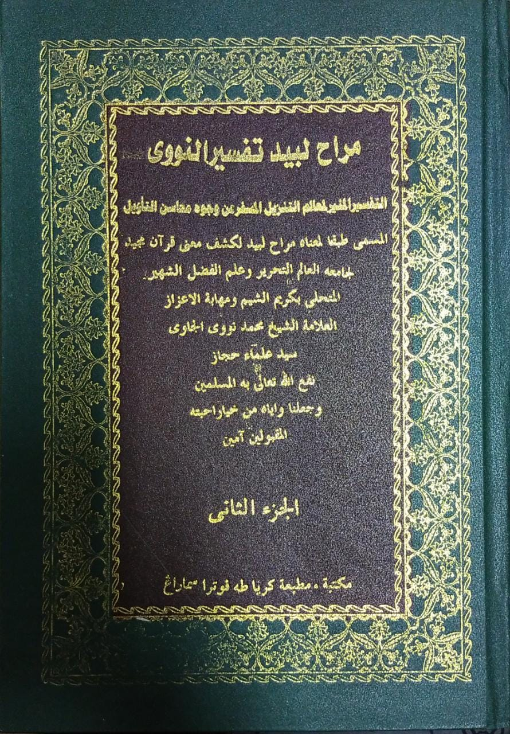
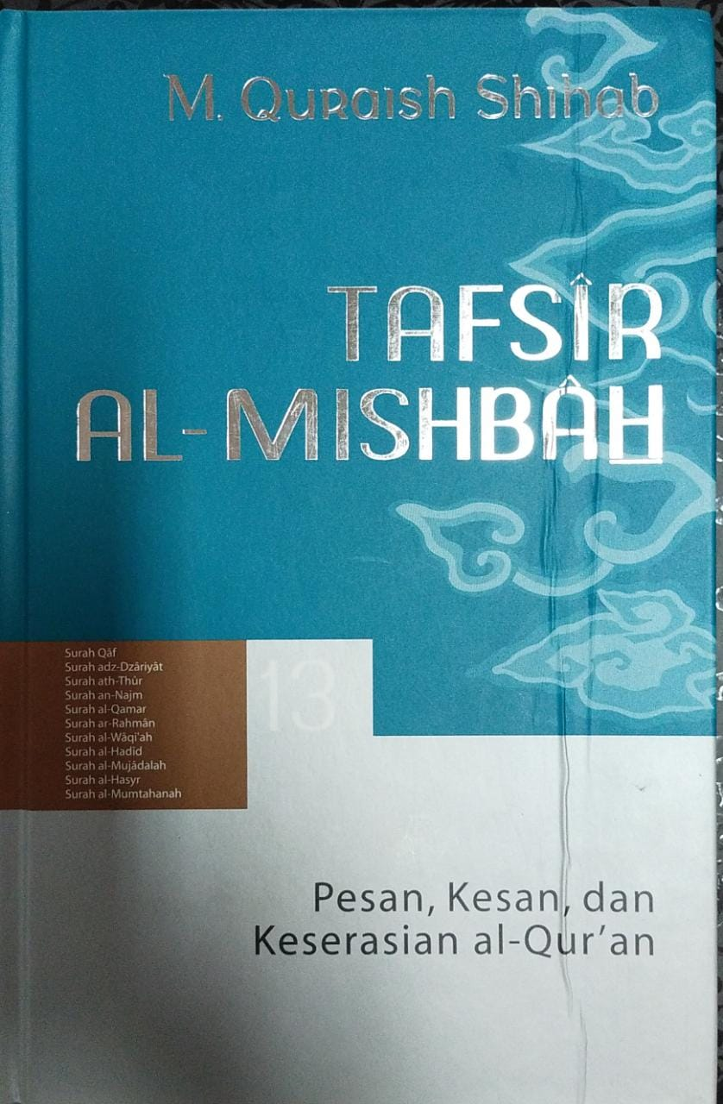

Slide 9
{ عَسَى ٱللَّهُ أَن يَجْعَلَ بَيْنَكُمْ وَبَيْنَ ٱلَّذِينَ عَادَيْتُم مِّنْهُم مَّوَدَّةً وَٱللَّهُ قَدِيرٌ وَٱللَّهُ غَفُورٌ رَّحِيمٌ }
[60:7] It may be that Allah will ordain love between you and those of them with whom ye are at enmity. Allah is Mighty, and Allah is Forgiving, Merciful.

Slide 10
The Prophet Muhammad’s and his companions’ practices of Islam are the essential in reading the Qur’an.
The performativity of reading the Qur’an is the other face a coin of informative one.

