Slide 1
CASE STUDY: Prevention of Violent Extremism
By Dr. Atik Tapipin, M.M.Pd
The Association of Religious Education Teacher of Indonesia (AGPAII)
Lecture of Sekolah Tinggi Ilmu Tarbiyah Manggala Bandung
Online International conference:
May 25, 2023
“Religion and Citizenship - the educational challenges;
contextual hermeneutics and dialogical competencies
as a way out of conflictuous dilemma’s”

Slide 2
WORK MAP OF PREVENTING VIOLENT EXTREMISM (PVE)
S
C
H
O
O
L
&
C
L
A
S
S
R
O
O
M
C
U
L
T
U
R
E
POLICY STRENGTHENING
Trans National Ideology
O
N
L
I
N
E
&
O
F
L
I
N
E
I
N
T
E
R
V
E
N
S
I
Isra School
ACTOR
ACTOR
ACTOR
ACTOR
Eksklusive Recitation
Radical ekstrimisme
STRENGTHENING PAI Teacher & STUDENT

Slide 3
PVE PROGRAM APPROACH
NETWORKING
STRUCTURAL APPROACH
PARTISIPATIF

Slide 4
PVE SUCCESS STRATEGIES PROGRAME
SCHOOL CULTURE (KEPALA SEKOLAH)
CLASS ROOM CULTURE (GURU)
PEACE CORNER ( SISWA )

Slide 5
TARGET SCHOOL INTERVENTION
1. Curriculum intervention (Especially Spiritual Curriculum)
A.
Include 4 issues in spiritual material
B.
Develop Spiritual Mentor Training
Thoghut
Khilafah
Against violence in the name of religion
Jihad

Slide 6
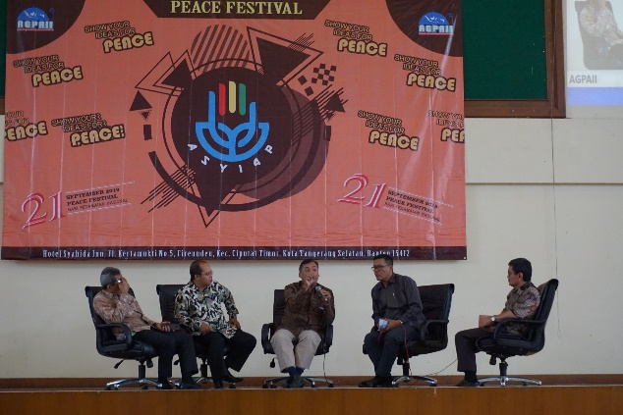
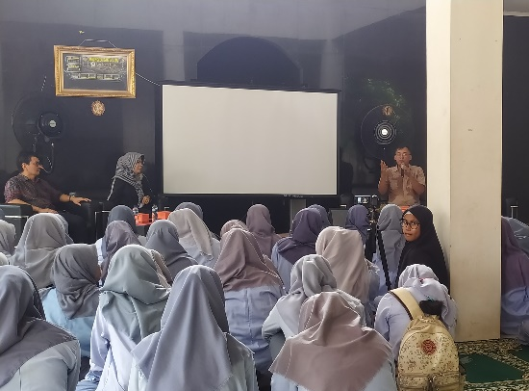
2. School Program Intervention
Academy Show Your Idea's for Peace
ASYI4P
NETWORKING
PEACE FESTIVAL
X T Sharing
Forming the Asyi4p (Academy Of Show Your Idea's For Peace) Program at school
Developing School Spiritual Networks
Held a Tangsel-wide Spiritual Peace Festival with 2,300 student Peace Quotes, 300 student letters on actual issues of peace, radicalism, juvenile delinquency
Presenting former terrorist Sofyan Tsauri Fauzi as a spiritual mentor and school activities.

Slide 7
3. Principal Policy Intervention
Principal
As a strategic local actor, the Principal is encouraged to be sensitive to the threat of the entry of Radical Terrorism (4 Main Issues)
Spiritual Management Policy and Recruitment of Spiritual Mentors
Presenting Former Terrorists

Slide 8
4. School Budget Intervention (RAPBS & BOS)
BOS
$
STILL IN PROCESS
BOP

Slide 9
PVE PRODUCT
Pocket Book of 4 Issues for Mentoring Materials
PVE Implementation book in schools
COMMUNITY DEVELOPMENT
FORNUSA
(Nusantara Rohis Forum)
400 Students
South Tangerang

Slide 10
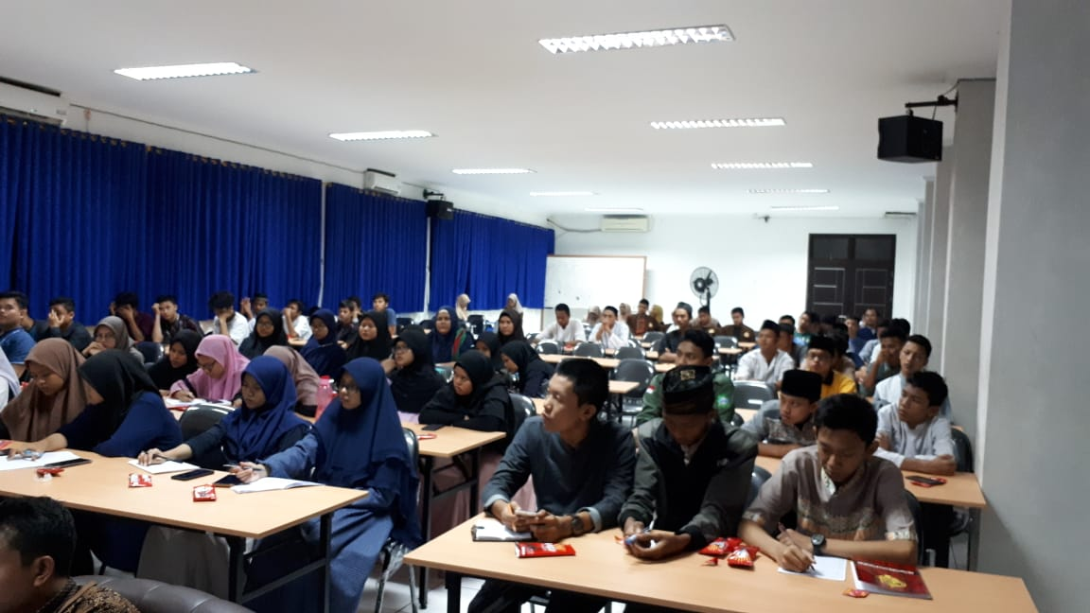
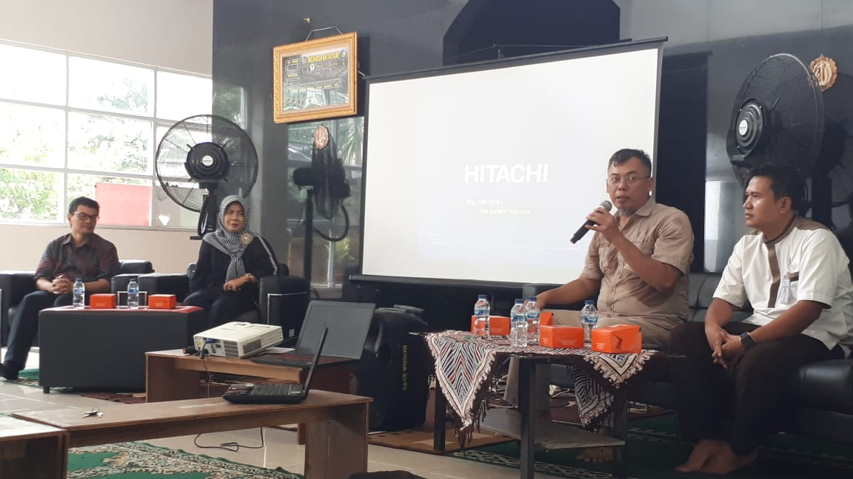
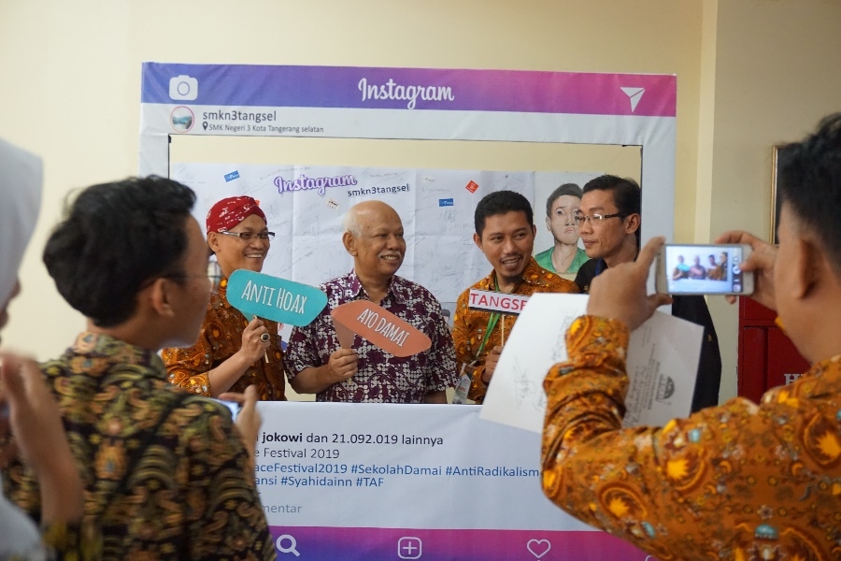
Rohis Camp
Rohis Training
Peace Festival

