Slide 1
Contextuality and Interpretation
A View From the Centre of Contextual Biblical Interpretation, Vrije Universiteit Amsterdam

Slide 2

A Gift and a Challenge
Contextuality is a fact
A gift: one needs a point of view to develop a perspective
A challenge: one cannot see everything

Slide 3

Positions of Reading
Reading without
Reading for
Reading with
And..reading with oneself: positionality

Slide 4
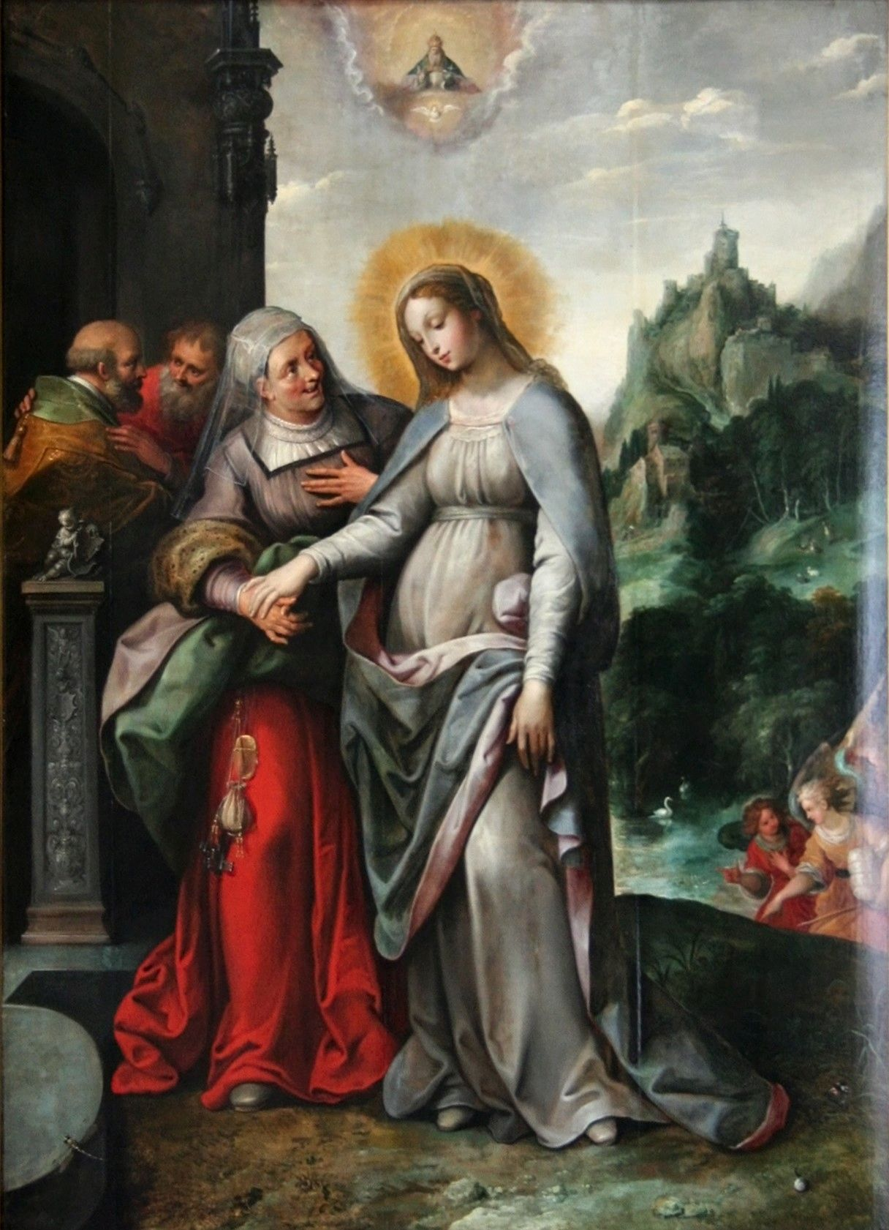
Gains?
An ethos of otherness is implied: reading is a communal and ideally reconciling activity
Boundary: readings that exclude the other are not appropriate
Requirement: willingness to listen – hence: logical connection between academia en society
Listenening to other voices can be immensely enriching – as can be relativizing one's own "absolute" view

