Slide 1
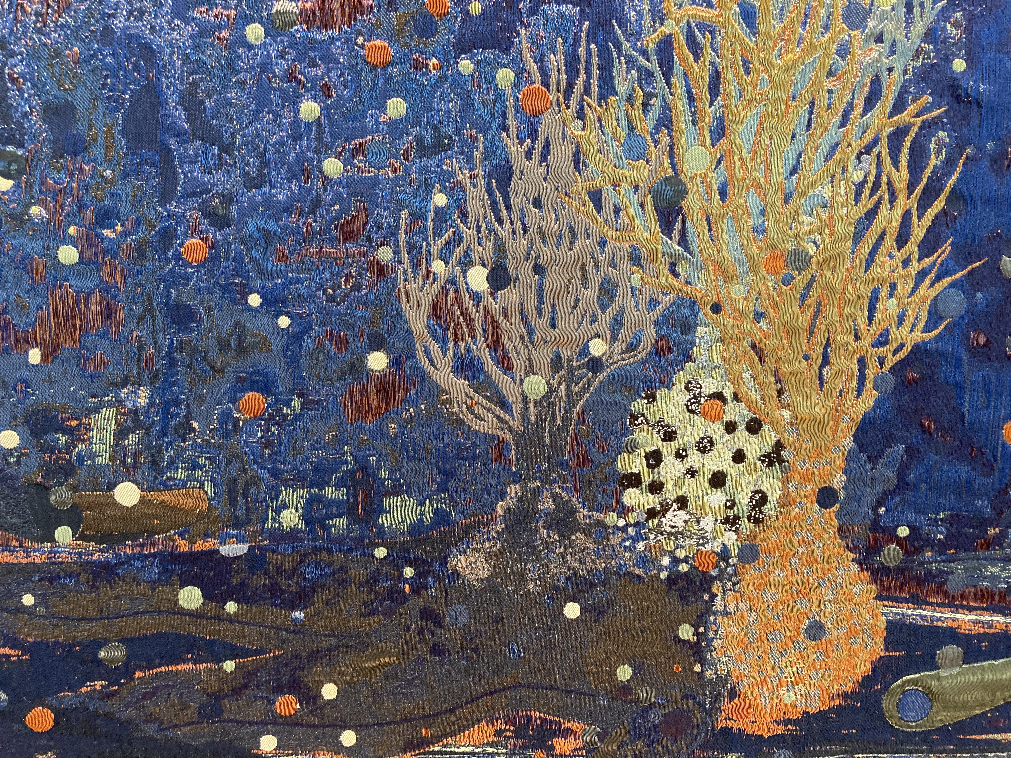

Spiritual Care and Planetary Health
Hans Alma
Chair spiritual care and religious humanism
1

Slide 2

Introduction
Spiritual care (‘geestelijke verzorging’)– understood as a value-driven, research-based profession that supports people facing existential challenges
Spiritual Care: professional assistance and counseling with regard to existential questions and the search for meaning in life
2
Spiritual Care and Planetary Health

Slide 3
Introduction
Planetary Health: a “holistic systems view of the world, recognizing the interconnectedness of the health and well-being of all life on Earth, and the need to regenerate natural systems, rather than simply minimizing harm.” (Martens, 2023, p.23)
3
Spiritual Care and Planetary Health

Slide 4
Introduction
How can we speak of spiritual health when we don’t take our relationship to other living beings and to the earth into account?
Existential challenges:
“Climate change is the defining existential event of our age.” (LaMothe, 2022)
4
Spiritual Care and Planetary Health

Slide 5
Introduction
How do religions and other worldviews affect spiritual and planetary health, either in perpetuating contemporary ecological crises or in offering critical perspectives for transformation?
From an anthropocentric to an ecocentric worldview
5
Spiritual Care and Planetary Health

Slide 6
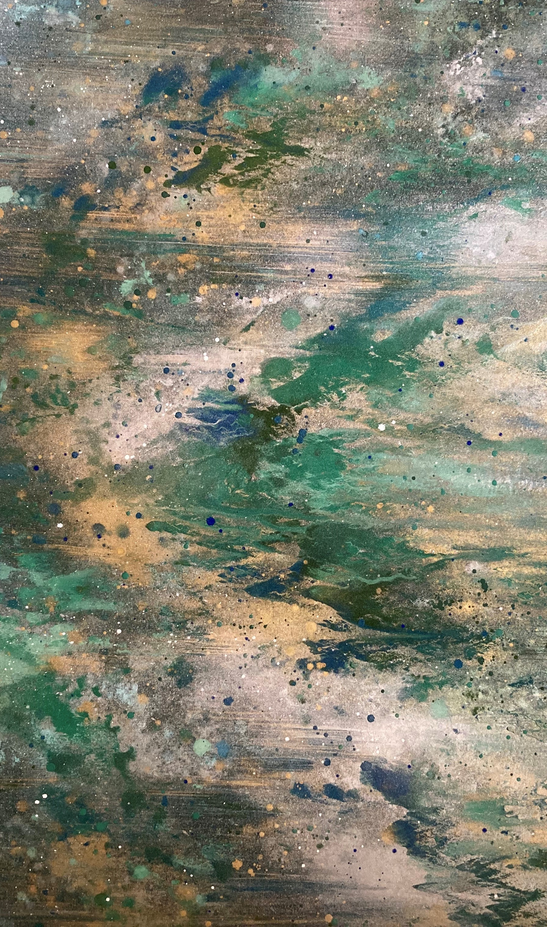
Dark Green Religion
Bron Taylor (2010):
Green religion (or greening of religion) posits that environmentally friendly behavior is a religious obligation
Dark green religion considers nature to be sacred, imbued with intrinsic value, and worthy of reverent care
6
Spiritual Care and Planetary Health

Slide 7
Dark Green Religion
Dark green religion:
Flowing from a deep sense of belonging to and connectedness in nature
Perceiving the earth and its living systems to be sacred and interconnected
Biocentric/ecocentric, considering all species to be intrinsically valuable
Cosmic humility and a corresponding critique of human moral superiority
7
Spiritual Care and Planetary Health

Slide 8

Spiritual Care and Planetary health
How can spiritual care support people in facing the existential challenge of local and global ecological crises?
Is it the task of spiritual care givers to critically reflect on the anthropocentric elements in their worldview and explore alternatives?
Do spiritual care givers have a responsibility when it comes to balancing the needs and capacities of human earthlings with those of the ecological whole?
8
Spiritual Care and Planetary Health

Slide 9
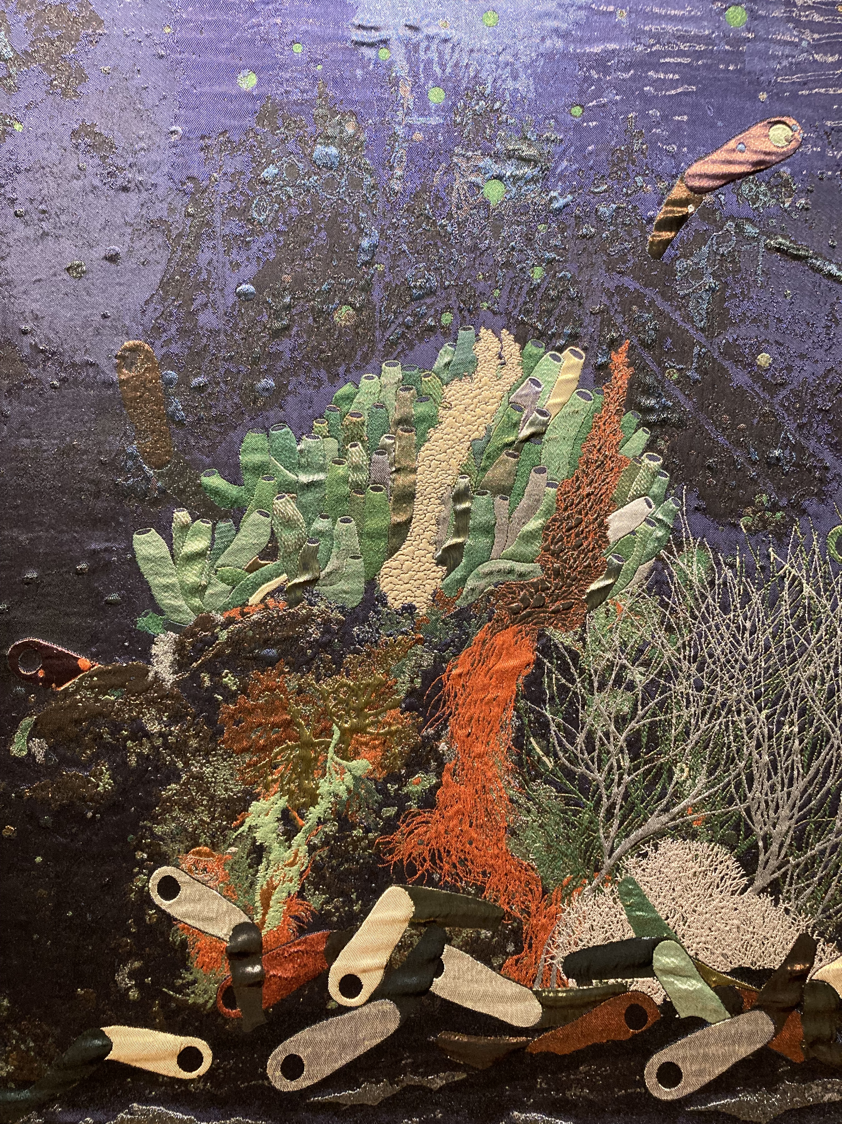
Spiritual Care and planetary Health
Examples:
Humanist Association (Humanistisch Verbond): Climate Free Space (Klimaatvrijplaats) to support climate activists
Dominicus Church, Amsterdam City Center: monthly climate vigils to share concerns about the earth
Joanna Macy: Council of All Beings as a ritual process to give expression to the consciousness and grief of nonhuman entities
9
Spiritual Care and Planetary Health

Slide 10

Research Perspectives
How can we conceive of nature in thinking about spiritual care and planetary health (‘is nature sacred?’, ‘is nature an obsolete concept?’)
What does spiritual health mean when we fully take our relationship to other living beings and to the earth into account?
What case studies allow for empirical research into the processes and outcomes of spiritual care approaches in relation to planetary health?
10
Spiritual Care and Planetary Health

